Slide 1
Types of Reasoning

Slide 2
Reasoning
Monotonic Reasoning
When facts and rules help to infer new information through logical reasoning.
When some conclusion is drawn as true, it remains true under all circumstances e.g.:- Proving mathematical theorems etc.
Non-monotonic Reasoning
When new facts contradict the earlier ones and remove the same fact from the database. This type of reasoning is called non-monotonic reasoning.
Example:- if a patient has symptoms of vomiting, as per general belief it is due to food-poisoning (a conclusion is drawn) but after investigation and medical tests, it is found that the disease actually is Diarrhoea (the conclusion is changed).

Slide 3

Statistical Reasoning
When reasoning is totally based on statistical ideas.
Interpretations are totally based on data, graphical representations etc.
Types of Statistical Reasoning
  Reasoning about data:- recognizing or categorization of data as quantitative or qualitative, discrete or continuous.
  Reasoning about representation of data:- Understanding the way in which a plot is meant to represent a sample, understanding how graphs may be modified to better represent a data set.
  Reasoning about uncertainty:- correctly using ideas of randomness, chance and likelihood to make judgments about uncertain events.
Notes:
St

Slide 4
Temporal Reasoning
Temporal logics use modal operators in relation to concepts of time, such as past, present, future, sometimes, always etc.
Spatial/Temporal Reasoning:-
Humans give reasons about space and time through both quantitative and qualitative assertions (belief) and relationships.
  That object is closer to me.
  That event occurred a long time ago.
  That event happened 6 minutes and 30 seconds ago.
Humans use these assertions to make decisions in their interactions with their environment. E.g., if an object is very close to me and if it is a heavy object, it might hurt me and I have to avoid it by moving aside (decision).

Slide 5
Symbolic Reasoning
Symbolic reasoning is the ability to manipulate abstract symbols mentally and to make judgments and decisions which are logically valid.
Example:-
  in prolog , if-then rules define reasoning between words in English language.
  In mathematics, theorem proving involves mathematical rules such as theorems, formulae, identities, etc. using mathematical symbols to reach a new result by proving a theorem.

Slide 6
Fuzzy Reasoning
Fuzzy set theory is a means of specifying how well an object satisfies an unclear description. E.g.
  This building is very beautiful.
    Fuzzy viewpoint:- How much “beautiful”?
  He is a fat boy.
    Fuzzy viewpoint:- How much “fat”?
Fuzzy systems allow the degree of belonging or the degree of membership to vary between 0 and 1. If the degree of membership is exactly equal to either 0 or 1, we say that the variable is non-fuzzy or crisp.
Fuzzy if – then rules
General Format
  If x is A then y is B
  Examples:
    If the road is rather slippery, then driving is somewhat dangerous.
    If speed is high, then apply the brakes hard.

Slide 7
Dempster-Shafer Theory
Designed to deal with the distinction between uncertainty and ignorance.
It computes the probability that the evidence supports the proposition rather than computing the probability of a proposition.
It has measure of belief called belief function, Bel(X)

Slide 8
Cont..
Taking an example of coin flipping:-
Let a shady character come to you and say that this coin will come up heads on the next flip.
  Given that the coin might or might not be fair.
Q. What belief should you assign to the event that it comes up heads?
Now DST says that because you have no evidence either way, so :-
belief Bel(Heads)=0 and also that Bel(¬Heads)=0
This makes DST, a doubtful reasoning system.
Now let, an expert be with you, who testifies with 90% certainty that the
coin is fair i.e P(Heads)=0.5
Then DST gives Bel(Heads) = 0.9 × 0.5 = 0.45
and likewise Bel(¬ Heads) = 0.45
And there is still a 10% point gap, that is not accounted for by the evidence.

Slide 9
Hidden Markov Model (Motivation)
Real-world has structures and processes which have (or produce) observable outputs
  Usually sequential (process unfolds over time)
  Cannot see the event producing the output
    Example: speech signals
Problem: how to construct a model of the structure or process given only observations

Slide 10
HMM Background
Basic theory developed and published in 1960s and 70s
No widespread understanding and application until late 80s
Why?
  Theory published in mathematic journals which were not widely read by practicing engineers
  Insufficient tutorial material for readers to understand and apply concepts

Slide 11

HMM Uses
Uses
  Speech recognition
    Recognizing spoken words and phrases
  Text processing
    Parsing raw records into structured records
  Bioinformatics
    Protein sequence prediction
  Financial
    Stock market forecasts (price pattern prediction)
    Comparison shopping services

Slide 12
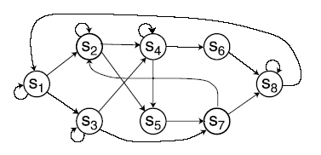
HMM Overview
Machine learning method
Makes use of state machines
Based on probabilistic models
Useful in problems having sequential steps
Can only observe output from states, not the states themselves
  Example: speech recognition
    Observe: acoustic signals
    Hidden States: phonemes
      (distinctive sounds of a language)
State machine:

Slide 13
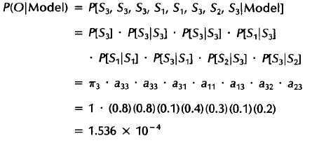
Observable Markov Model Example
State transition matrix
Weather
  Once each day weather is observed
    State 1: rain
    State 2: cloudy
    State 3: sunny
  What is the probability the weather for the next 7 days will be:
    sun, sun, rain, rain, sun, cloudy, sun
  Each state corresponds to a physical observable event
 | Rainy | Cloudy | Sunny
Rainy | 0.4 | 0.3 | 0.3
Cloudy | 0.2 | 0.6 | 0.2
Sunny | 0.1 | 0.1 | 0.8

Slide 14
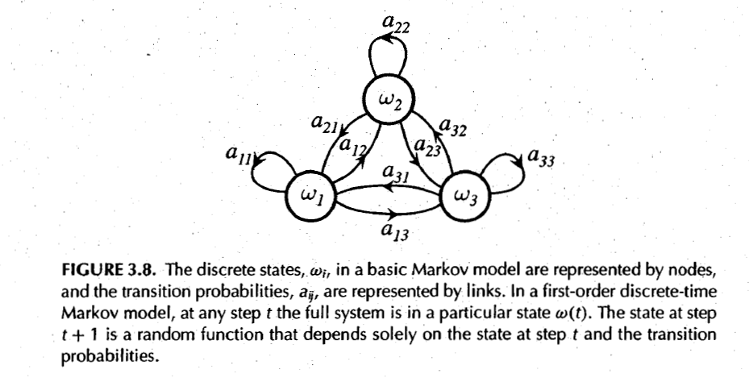
Observable Markov Model

Slide 15
Hidden Markov Model Example
Coin toss:
  Heads, tails sequence with 2 coins
  You are in a room, with a wall
  Person behind wall flips coin, tells result
    Coin selection and toss is hidden
    Cannot observe events, only output (heads, tails) from events
  Problem is then to build a model to explain observed sequence of heads and tails

Slide 16
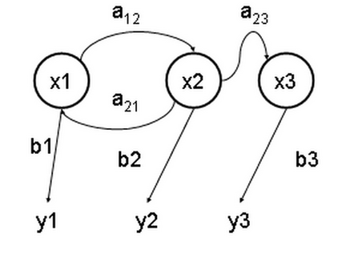
HMM Components
A set of states (x’s)
A set of possible output symbols (y’s)
A state transition matrix (a’s)
  probability of making transition from one state to the next
Output emission matrix (b’s)
  probability of emitting/observing a symbol at a particular state
Initial probability vector
  probability of starting at a particular state
  Not shown, sometimes assumed to be 1

Slide 17
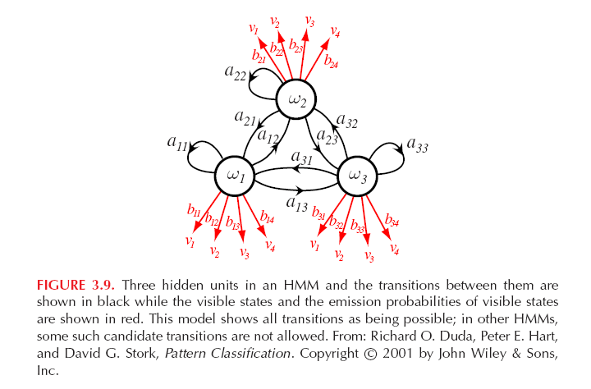
HMM Components

Slide 18
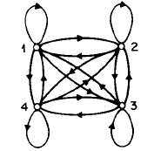
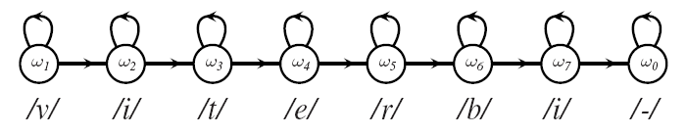
Common HMM Types
Ergodic (fully connected):
  Every state of model can be reached in a single step from every other state of the model
Bakis (left-right):
  As time increases, states proceed from left to right

Slide 19
HMM Core Problems
Three problems must be solved for HMMs to be useful in real-world applications
      1) Evaluation
      2) Decoding
      3) Learning

Slide 20
HMM Evaluation Problem
Purpose: score how well a given model matches a given observation sequence
  Example (Speech recognition):
    Assume HMMs (models) have been built for words ‘home’ and ‘work’.
    Given a speech signal, evaluation can determine the probability each model represents the utterance

Slide 21
HMM Decoding Problem
Given a model and a set of observations, what are the hidden states most likely to have generated the observations?
  Useful to learn about internal model structure, determine state statistics, and so forth

Slide 22
HMM Learning Problem
Goal is to learn HMM parameters (training)
  State transition probabilities
  Observation probabilities at each state
Training is crucial:
  it allows optimal adaptation of model parameters to observed training data using real-world phenomena
No known method for obtaining optimal parameters from data – only approximations
Can be a bottleneck in HMM usage

Slide 23
HMM Concept Summary
Build models representing the hidden states of a process or structure using only observations
Use the models to evaluate probability that a model represents a particular observation sequence
Use the evaluation information in an application to: recognize speech, parse addresses, and many other applications

Slide 24
HMM Advantages / Disadvantages
Advantages
  Effective
  Can handle variations in record structure
    Optional fields
    Varying field ordering
Disadvantages
  Requires training using annotated data
    Not completely automatic
    May require manual markup
    Size of training data may be an issue

Slide 25
Application to Other Domains
E-Commerce
  Comparison shopping sites
    Extract product/pricing information from many sites
    Convert information into structured format and store
    Provide interface to look up product information and then display pricing information gathered from many sites
  Saves users time
    Rather than navigating to and searching many sites, users can consult a single site

